Slide 1
Quality Refresher

Slide 2
Leaving annotations
In order to provide better customer service we need to leave notes on 2 different systems which are
IDA
Remedy
Which accounts do we leave notes on?
All the accounts that we access.

Slide 3
Why?
They are the register of everything you did on the account.
They help other agents have an idea of what is going on on the account.
They are a requirement from Altice directly.

Slide 4
IDA
At the end of the chat
1.Make sure you click on Call Wrap .

Slide 5
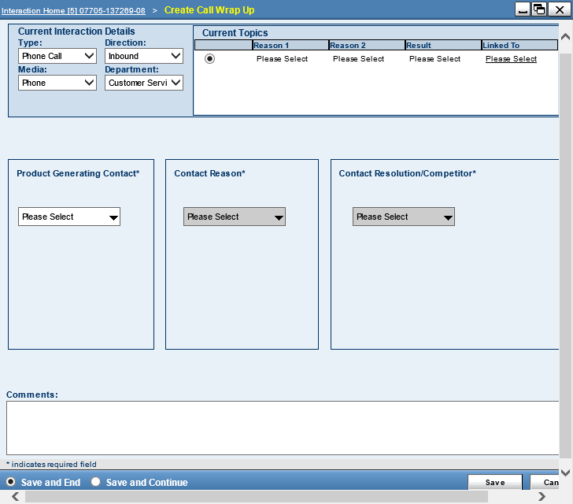
IDA
2. Make sure you change from phone call to live chat and select the topic of the call. As you open tabs in IDA it saves the activity

Slide 6
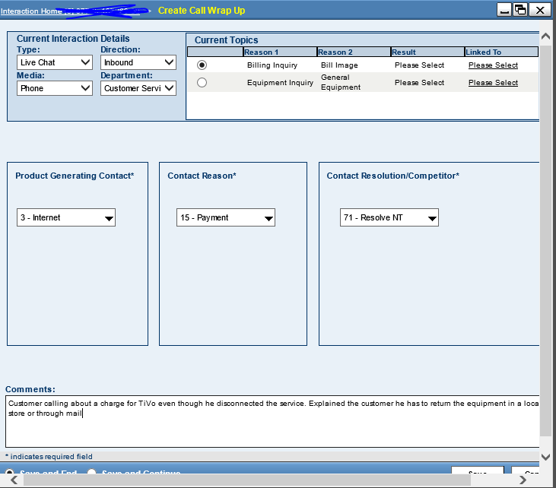
3. Leave your notes. You need to include here a brief description of the problem and the resolution. Along with the conversation ID

Slide 7
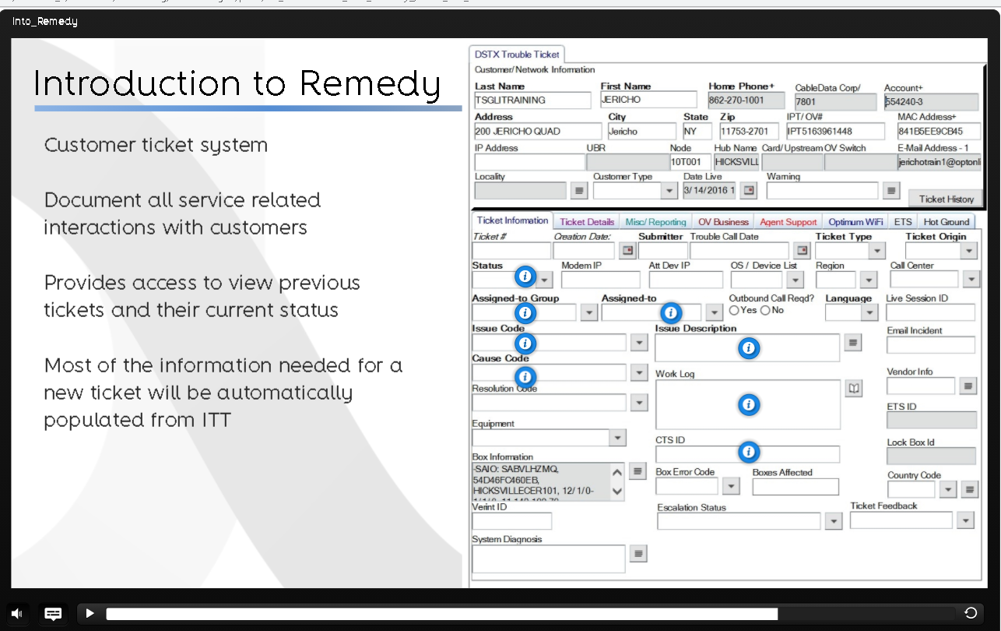
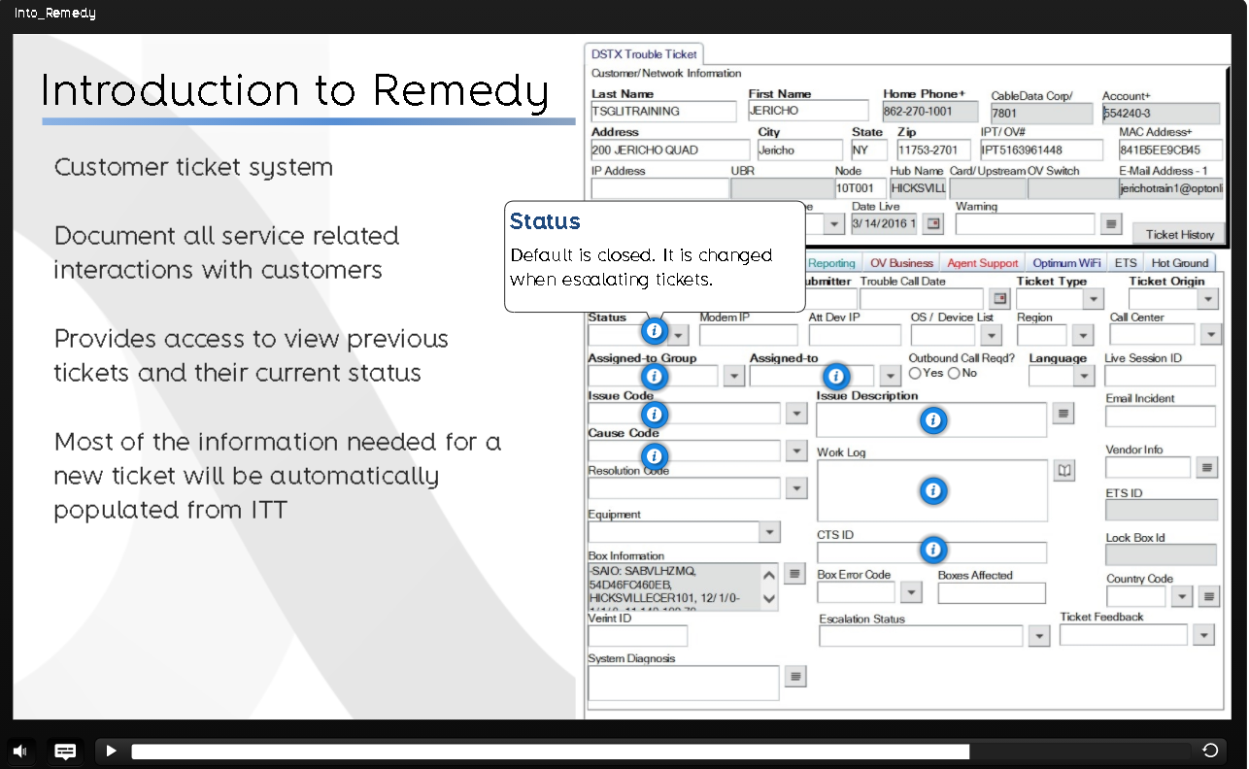
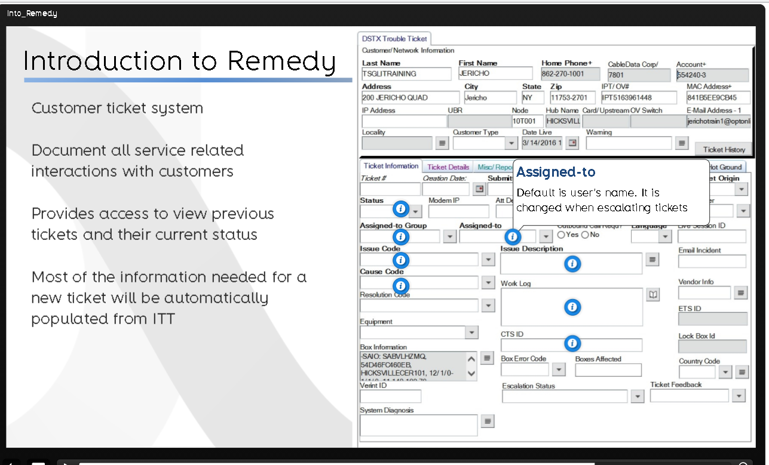
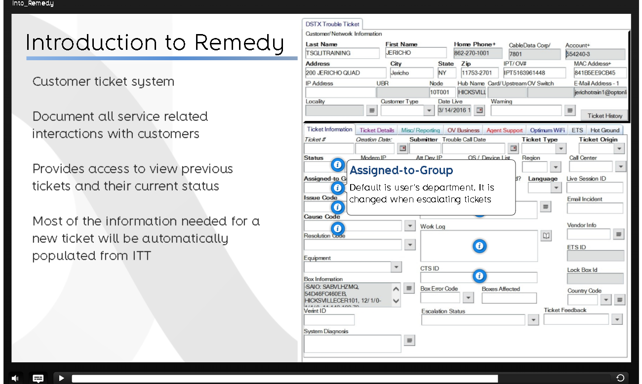
Remedy
Layout
Life session ID Here you MUST paste the conversation ID

Slide 8
